Slide 1
CREDIT CARD COMPLAINTS ANALYSIS USING TRANSFORMERS (Natural Language Processing)
-By
Bansari Shah
Komal Londhe
Jeevan Sai Sreela
Vaishavi Vejella
Under the guidance of Dr.Tony Diana
DATA 690-Natural Language Processing

Slide 2
VAISHNAVI VEJELLA
HX74171
JEEVAN SAI SREELA
OM75175
BANSARI SHAH
ZH92730
KOMAL LONDHE
AY10453

Slide 3
TABLE OF CONTENTS
01
02
03
04
OVERVIEW
DATASET DESCRIPTION
Source of Data, description of size and columns
Overview of credit card complaints analysis and Problem Statements
METHODOLOGY
RESULTS AND FINDINGS
Approach used for the project
Final conclusions on analysis

Slide 4
Why credit card complaints analysis is important?
Determines customers overall satisfaction
Assist companies to enhance functionality and security based on the sentiments
What is the role of transformers in the analysis?
Overview
Summarizing the complaints for analysis
Predicting and Categorizing the sentiments (Emotions and Intent of the complaints)
What is the importance of Machine Learning model?
ML is incorporated with transformers to build a model that can predict the intent behind the complaints
Used to address the issues for improving customer happiness

Slide 5
Problem Statement
01
02
Which state and credit card company are receiving highest number of complaints?
What are the common sub-issues related to credit-card products that are customers dissatisifed with?
03
04
What are the major concerns related to credit card services that affect the emotions and sentiments of the consumers?
How does the consumer feel about the credit card services offered considering the intent and emotions?

Slide 6
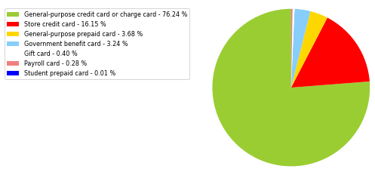

Dataset Description
Dataset source | Consumer Financial Protection Bureau (Consumer Complaint Database) From July 2017 to Jan 2022
No of complaints | 65981
Sub-Products | General-purpose credit cards or charge cards, gift cards, payroll cards, government benefit cards, and Student prepaid cards
Products | 23
Columns | Date received, Product, Sub-product, Issue, Sub-issue, Consumer complaint narrative, Company, State, Date sent to the company, company response, timely response, ComplaintID

Slide 7
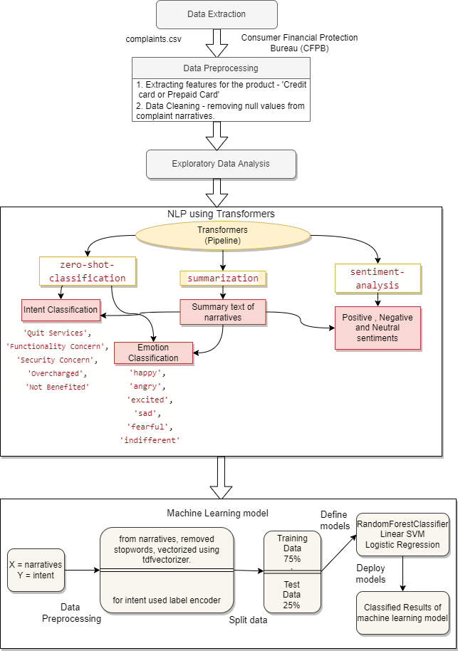
Methodology
Machine Learning
Stacking
NLP using Transformers
Summarization
Sentiment Analysis
Zero-shot classification (Intent & Emotion)
EDA
Data Preprocessing
Extracting features
Data Cleaning
Data Extraction
Consumer Financial Protection Bureau (CFPB)
Complaints.csv

Slide 8

Data Extraction
Download complaints.csv from Consumer Financial Protection Bureau (CFPB)
Load data into dataframe using read_csv()

Slide 9
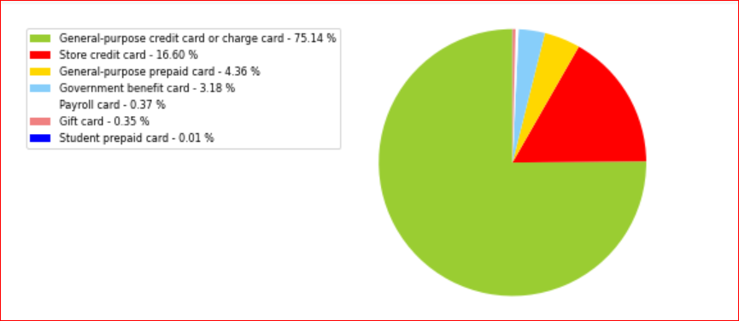
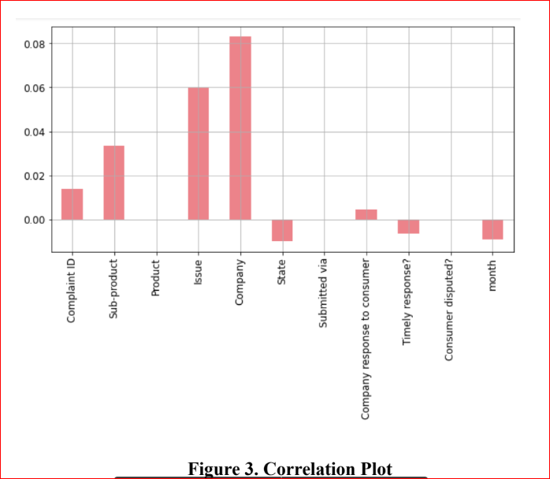
Data Preprocessing
Consider columns for analysis of Product - ‘Credit card or Prepaid card’
Remove null values from consumer complaints narratives
Find correlation with respect to complaint narratives

Slide 10
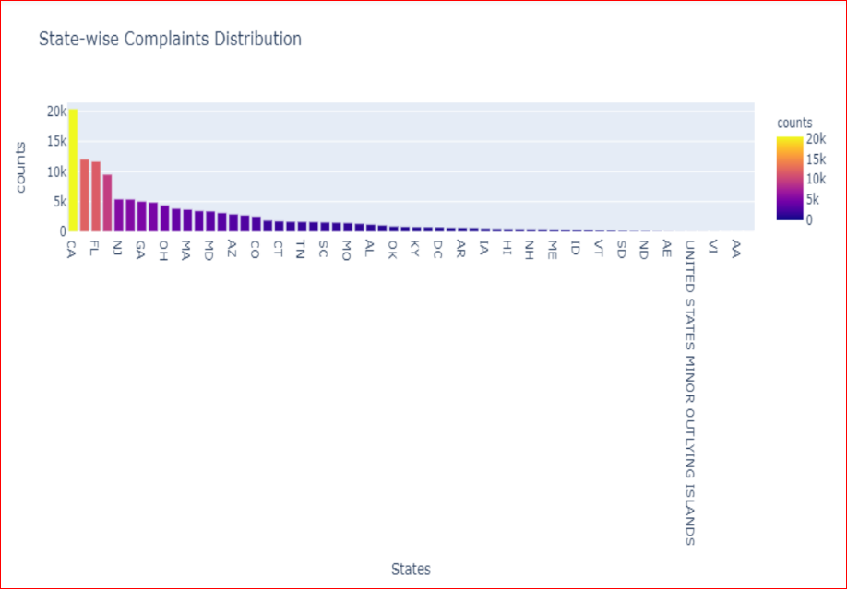
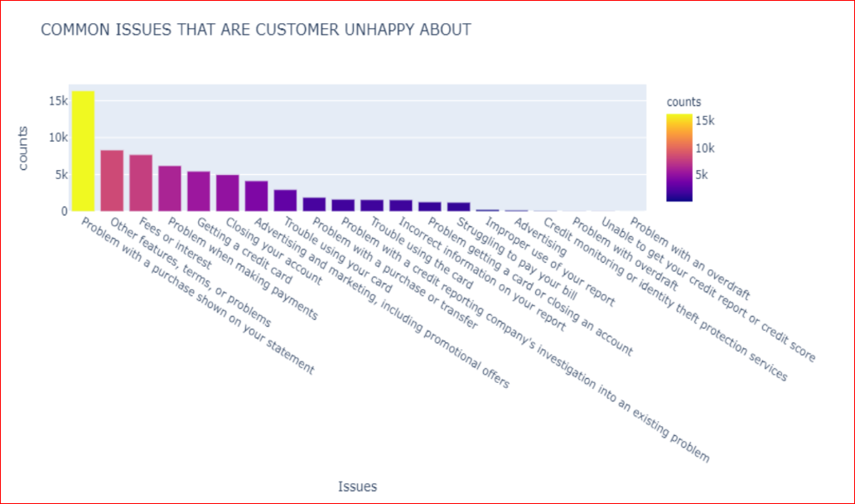
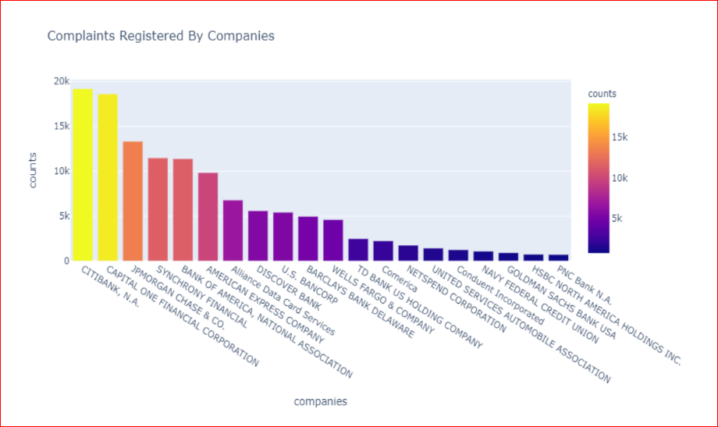
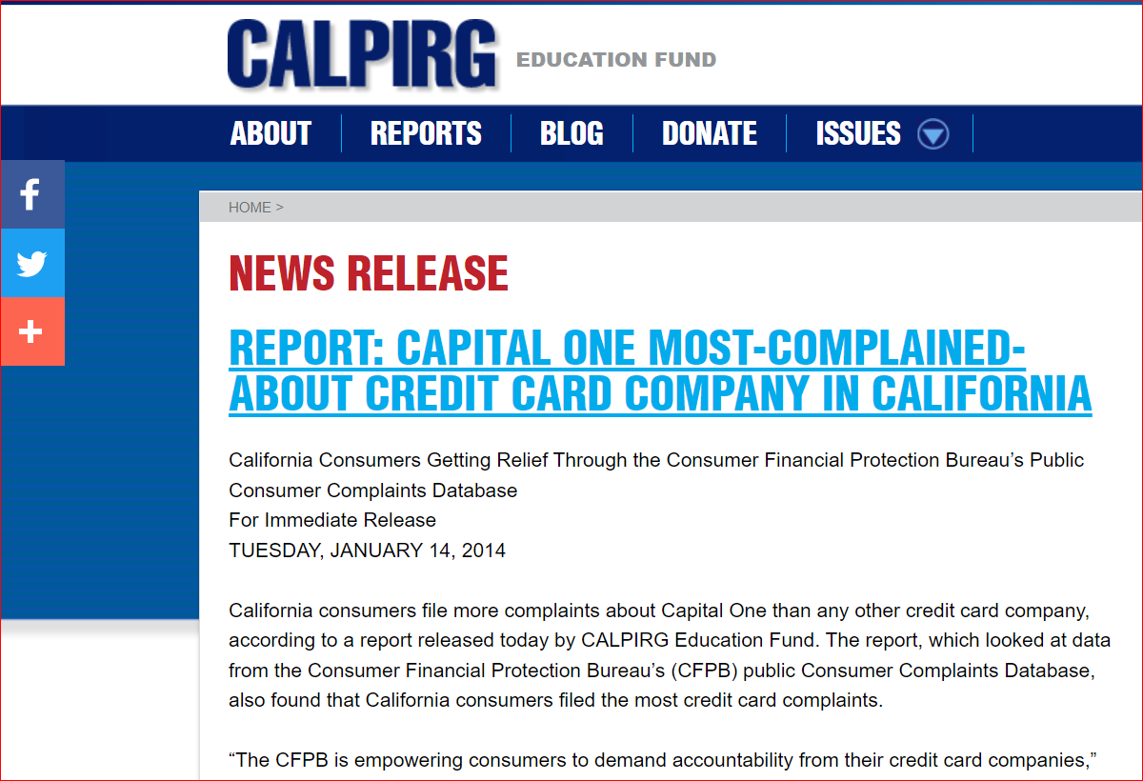
Exploratory Data Analysis
Which state and credit card company are receiving highest number of complaints?
01
What are the common sub-issues related to credit-card products that are customers dissatisifed with?
02

Slide 11
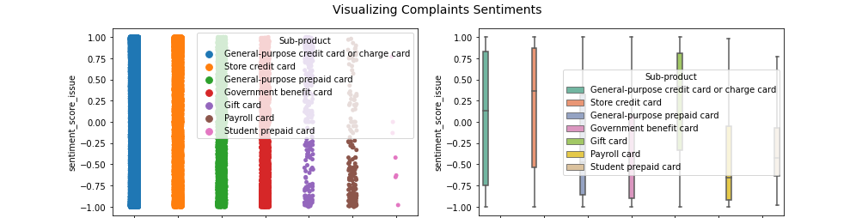



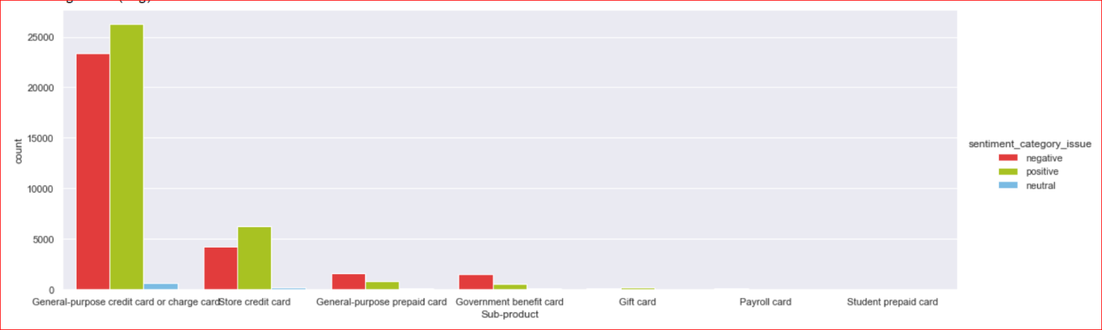
Vader Sentiment Analysis
Negative
Neutral
Positive
Complaints which are neither positive nor negative
Consumer feedback-Complaints are mostly negative
Complaints which are positive feedback for companies(Hypothetical in our case, as complaints can never be positive)

Slide 12
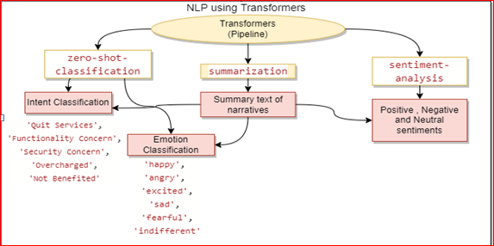
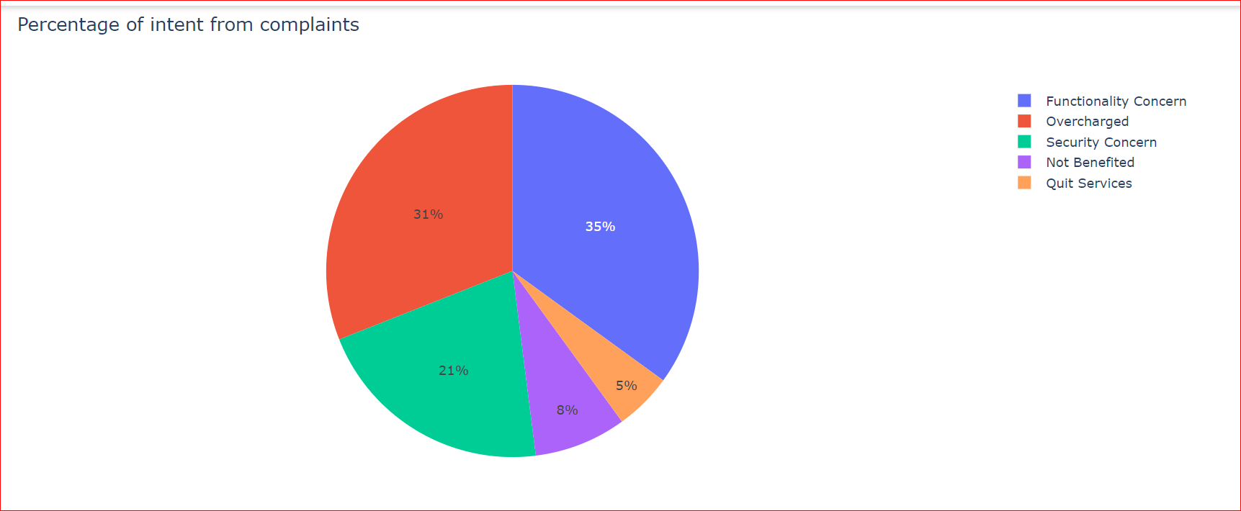
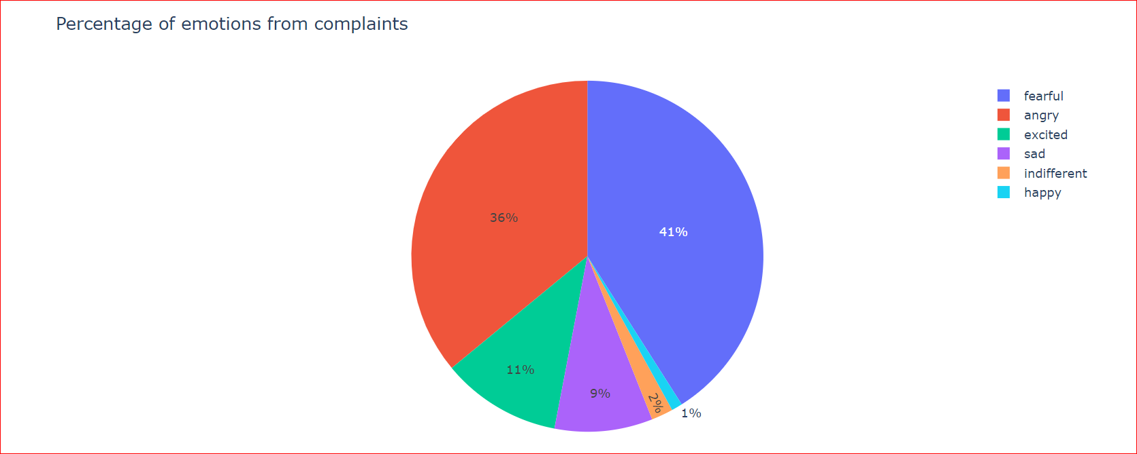
NLP using Transformers
Summarization of consumer narratives

Slide 13
Overcharged
Consumer wrote the complaint because he was overcharged for certain sub-product
Functionality Concern
Intent Classification using zero-shot
Consumer faced some issues while operating the credit card
Security Concern
Complaints of credit card been stolen or used without authentication
Not Benefitted
Consumer did not get any benefits from the subscribed sub-products
Quit Services
Consumer is angry and is not going to continue with certain product of credit card company

Slide 14
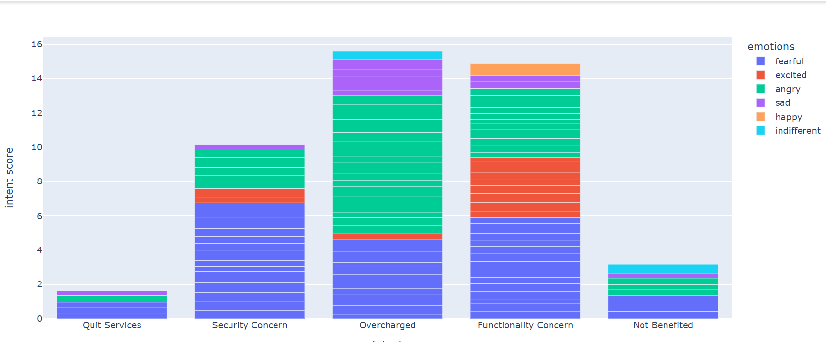
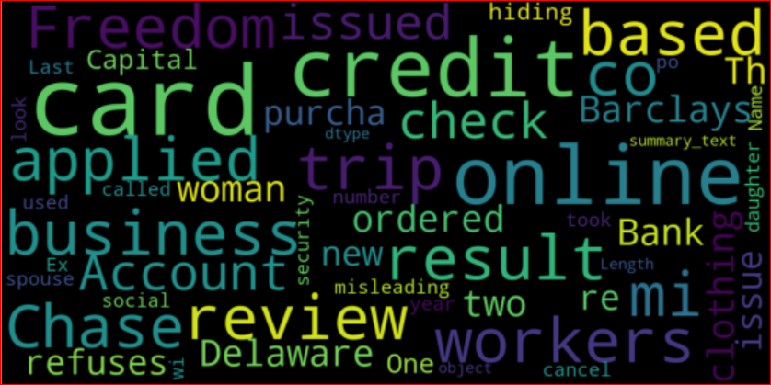
WordCloud of narrative summary
Transformers
Zero-shot classifications

Slide 15
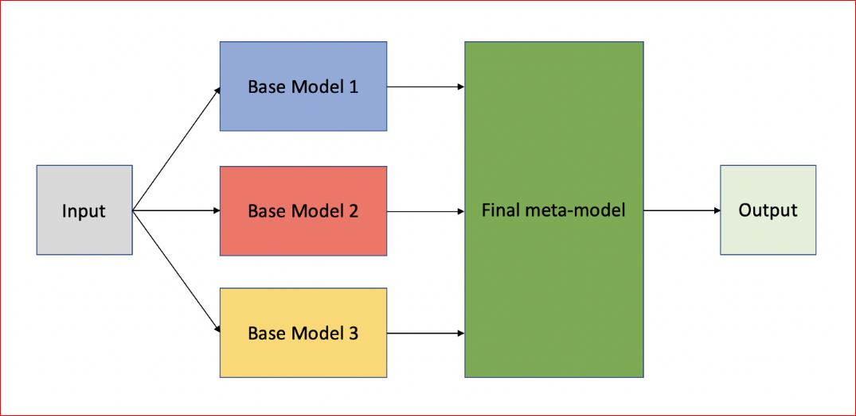
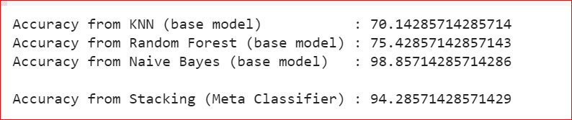
Machine Learning model
Stacking
Base Model 1
KNN classifier
Base Model 2
Meta Classifier
RandomForest Classifier
Logistic Regression
Base Model 3
GaussianNB classifier

Slide 16
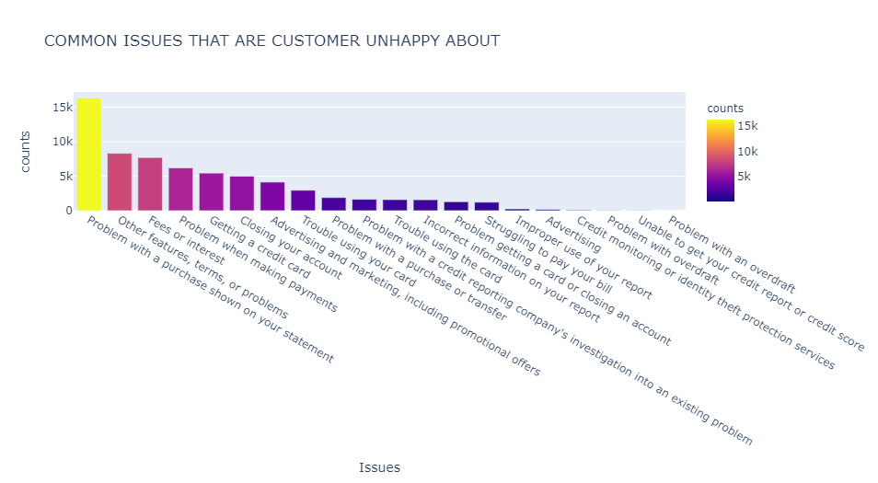
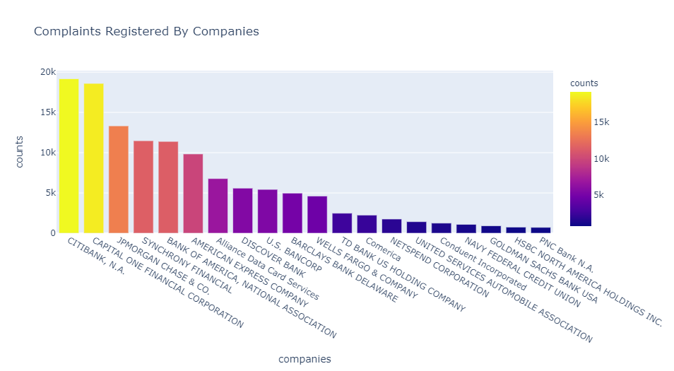
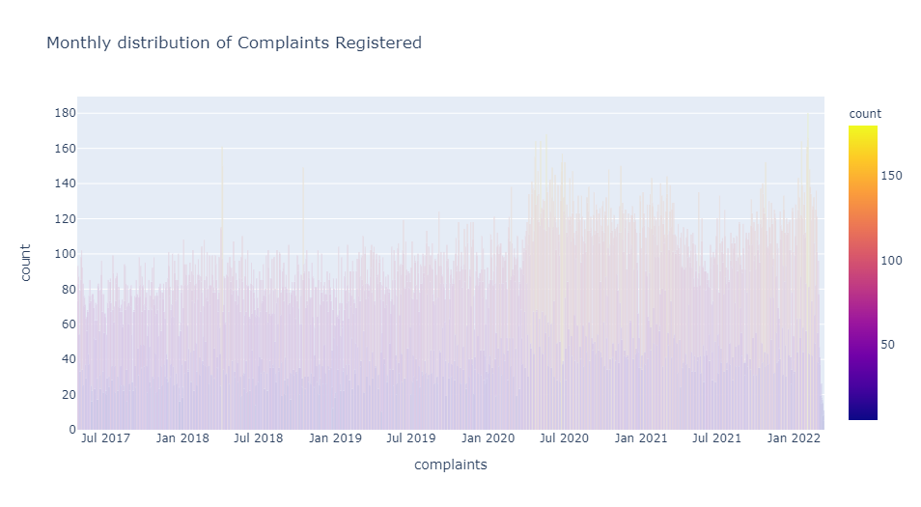

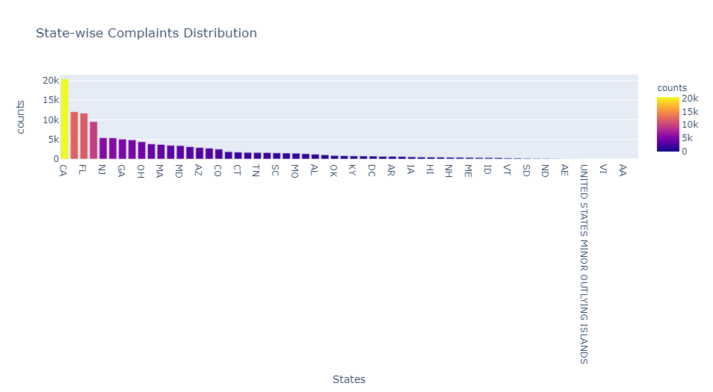
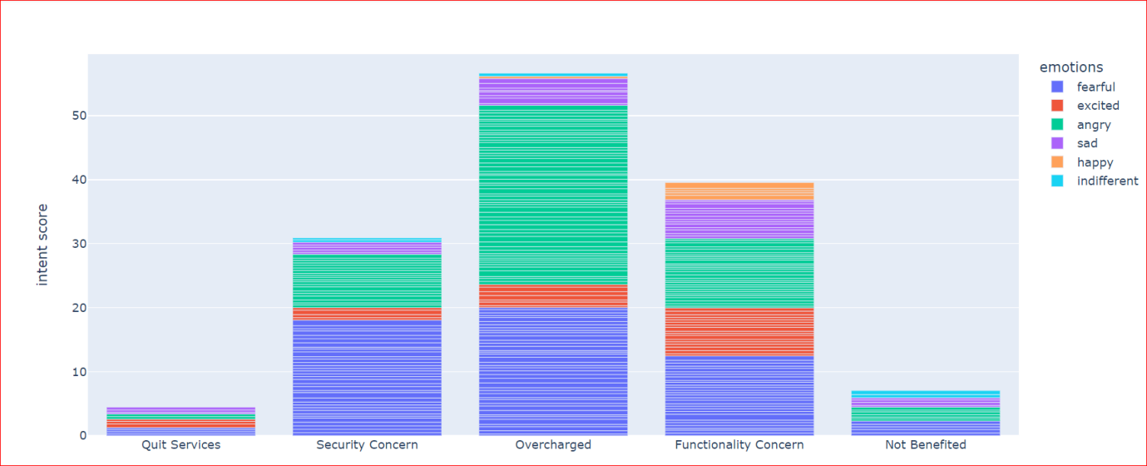
Results and Findings

Slide 17


Slide 18

CONCLUSION
Consumers are more fearful considering security concerns
When it comes to functionality concerns and overcharged, consumers feel angrier
Companies can use this analysis to enhance their credit card services

Slide 19


Slide 20


